Slide 1
Persistence 2: SQLite
CS 344 Mobile App Development
Robert Muller

Slide 2
Today
SQL Concepts
Using SQLite
Demo

Slide 3
SQL Concepts
SQL == Structured Query Language;
Query a front-end connected to a database;
SQL – very widely used;
SQLite : A light-weight version of SQL; fast with a small footprint
SQL/SQLite APIs available for most major programming languages: C, Java, Python, Ruby, …

Slide 4
An SQL Database is a Collection of Named Tables

Slide 5
An SQL Table has Columns (aka Fields) & Rows
Countries
Country | Continent | Capital | Population | Area
Mexico | North America | Mexico City | 106,000,000 | 1,923,039
Ghana | Africa | Accra | 23,000,000 | 238,540
Bolivia | South America | La Paz | 9,000,000 | 1,083,000
Italy | Europe | Rome | 60,000,000 | 301,230
France | Europe | Paris | 62,000,000 | 545,630

Slide 6
Each column has a given Name and Datatype
Countries
Country | Continent | Capital | Population | Area
Mexico | North America | Mexico City | 106,000,000 | 1,923,039
Ghana | Africa | Accra | 23,000,000 | 238,540
Bolivia | South America | La Paz | 9,000,000 | 1,083,000
Italy | Europe | Rome | 60,000,000 | 301,230
France | Europe | Paris | 62,000,000 | 545,630
Continent : string
Population : int

Slide 7
SQL Queries
A client (human or software) can issue queries that can:
retrieve information from the database;
create new tables;
can modify one or more of the tables in the database.

Slide 8
Countries
Country | Continent | Capital | Population | Area
Mexico | North America | Mexico City | 106,000,000 | 1,923,039
Ghana | Africa | Accra | 23,000,000 | 238,540
Bolivia | South America | La Paz | 9,000,000 | 1,083,000
Italy | Europe | Rome | 60,000,000 | 301,230
France | Europe | Paris | 62,000,000 | 545,630
sqlite> SELECT Country, Capital FROM Countries
Country | Capital
Mexico | Mexico City
Ghana | Accra
Bolivia | La Paz
Italy | Rome
France | Paris

Slide 9
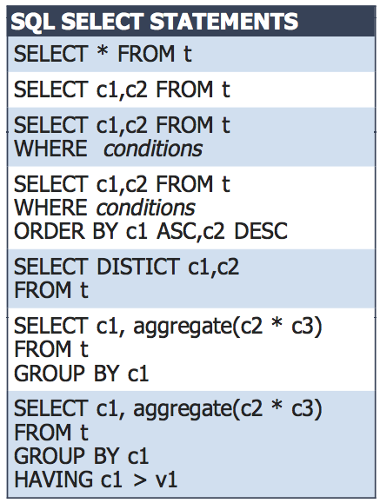
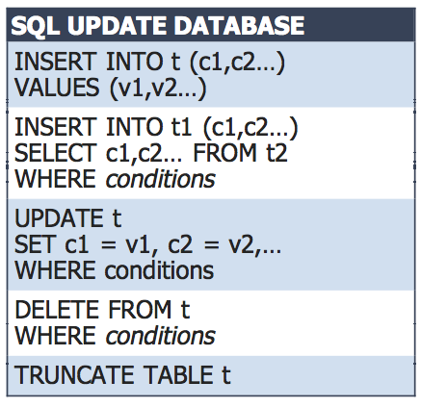

Slide 10
SQL Options
Sql Framework must be linked into project
DB made off-line and is read-only:
Can be made with sqlite3 command interface
Dropped into application bundle
Read/write DB:
Can be made off-line, stashed in bundle and then copied to Documents
Can be made and modified in Documents
DB is off-device

Slide 11
SQLite Interfaces
Command Line/Shell
APIs

Slide 12
SQL Command Line
> sqlite3 ./mydatbase.db
SQLite version 3.6.12
Enter ".help" for instructions
Enter SQL statements terminated with a ";"
sqlite>
sqlite> create table contacts (id integer primary key autoincrement, name text, address text, phone text);
sqlite> .tables
contacts

Slide 13
SQL Command Line
sqlite> insert into contacts (name, address, phone) values ("Michael Blair", "12 A Street, Berkeley CA", "916-555-2323");
sqlite> insert into contacts (name, address, phone) values ("Mike Parks", "10 Upping Street, Boise ID", “444-444-1212");
sqlite> select * from contacts;
1|Michael Blair|12 A Street, Berkeley CA|916-555-2323
2|Mike Parks|10 Upping Street, Boise ID|444-444-1212
sqlite> select * from contacts where name="Mike Parks";
2|Mike Parks|10 Upping Street, Idaho|444-444-1212
sqlite> .exit

Slide 14
Command Line Interface Populating the Countries Table
/> sqlite3
sqlite> CREATE TABLE Countries (Country TEXT,
Continent TEXT,
Capital TEXT,
Population integer,
Area integer);
sqlite> INSERT INTO Countries (Country, …, Area) VALUES
(’Mexico’, …, 1923039);
sqlite> …

Slide 15
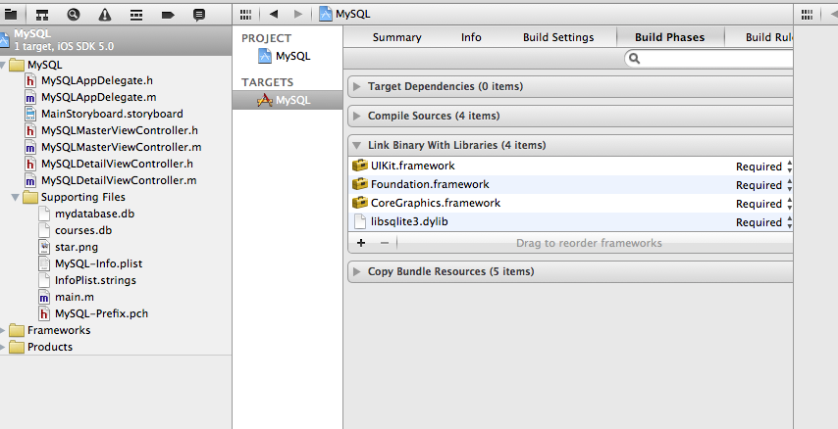
Linking the SQL Framework

Slide 16
Marshalling String Representations
NSString *querySQL =
@"SELECT COURSE_NUMBER, TITLE FROM COURSE";
const char *query_stmt = [querySQL UTF8String];

Slide 17
sqlite API
sqlite3_open() - Opens specified database file. If the database file does not already exist, it is created.
sqlite3_close() - Closes a previously opened database file.
sqlite3_prepare_v2() - Prepares a SQL statement ready for execution.
sqlite3_step() - Executes a SQL statement previously prepared by the sqlite3_prepare_v2() function.

Slide 18
sqlite API
sqlite3_column_<type>() - Returns a data field from the results of a SQL retrieval operation where <type> is replaced by the data type of the data to be extracted (text, blob, bytes, int, int16 etc).
sqlite3_finalize() - Deletes a previously prepared SQL statement from memory.
sqlite3_exec() - Combines the functionality of sqlite3_prepare_v2(), sqlite3_step() and sqlite3_finalize() into a single function call.

Slide 19
SQLite3 API for C : sqlite3.h
int sqlite3_open(const char *filename,
/* db filename */
sqlite3 **ppDb
/* OUT: db handle */
);

Slide 20
Digression : Pass-by-reference in C
sqlite3 *myDB = NULL;
int stat = sqlite3_open(@”myFile.db”, …);
Problem: sqlite3_open wants to “return” 2 values:
1. a handle for an opened database,
2. a status indicator telling the caller what happened.

Slide 21
Digression : Pass-by-reference in C
sqlite3 *myDB = NULL;
int stat = sqlite3_open(@”myFile.db”, myDB);
Stack Frame
“myFIle.db”
myDB
1000

Slide 22
Digression : Pass-by-reference in C
sqlite3 *myDB = NULL;
int stat = sqlite3_open(@”myFile.db”, myDB);
Stack Frame
“myFIle.db”
myDB
1000

Slide 23
Digression : Pass-by-reference in C
sqlite3 *myDB = NULL;
int stat = sqlite3_open(@”myFile.db”, &myDB);
Stack Frame
“myFIle.db”
myDB
1000

Slide 24
Digression : Pass-by-reference in C
sqlite3 *myDB = NULL;
int stat = sqlite3_open(@”myFile.db”, &myDB);
Stack Frame
“myFIle.db”
myDB
1000
1000

Slide 25
Digression : Pass-by-reference in C
sqlite3 *myDB = NULL;
int stat = sqlite3_open(@”myFile.db”, &myDB);
Stack Frame
“myFIle.db”
myDB
1000

Slide 26
Digression : Pass-by-reference in C
sqlite3 *myDB = NULL;
int stat = sqlite3_open(@”myFile.db”, &myDB);
Stack Frame
“myFIle.db”
myDB
An Actual
DB
1000

Slide 27
Digression : Pass-by-reference in C
sqlite3 *myDB = NULL;
int stat = sqlite3_open(@”myFile.db”, &myDB);
myDB
An Actual
DB
1000

Slide 28
SQLite3 API for C : exec
int sqlite3_exec(
sqlite3 *, /* An open db */
const char *sql, /* SQL cmd */
int (*callback)(void*, int, char**,char**),
/* Callback function */
void *, /* 1st arg to callback */
char **errmsg /* Error msg */
);

Slide 29
exec callbacks
int sqlite3_exec(sqlite3 *,const char *sql,
int (*callback)(void *, int, char**, char**),
void *, char **errmsg);
The callback is a function that will be executed once
For each row in the relation resulting from the query.

Slide 30
Demo

Slide 31
Documentation & Tutorials
See e.g.,
http://souptonuts.sourceforge.net/readme_sqlite_tutorial.html

