Slide 1
Persistence
CS 344 Mobile App Development
Robert Muller

Slide 2
Options
On-device or off-device;
Property Lists, NSUserDefaults
Archives
SQLite (Thursday)
Core Data (next Tuesday)
a higher-level & OO interface to SQLite
iCloud

Slide 3
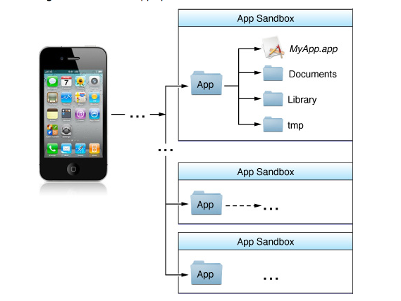

Slide 4
File System & Sandbox
Why use a sandbox:
Security
Privacy
Ease of management
App removal

Slide 5
File System & Sandbox
Each app is assigned a set of directories
<Application Home>
TheApp.app
TheApp
MainWIndow.xib
Info.plist
Image1.png,…
Documents <----- Persistent/Writeable Sandbox
Library
Caches
Preferences

Slide 6
Property Lists
Commonly used abstraction for storing structured configuration data;
Example: the Info.plist file found in every iOS app is a property list that stores configuration information about the app;
You can use property lists yourself to store additional information, such as the state of your app when it quits.

Slide 7
Property Lists
Utilize (restricted to) several Foundation datatypes:
dictionaries,
arrays,
strings,
dates,
binary data,
numerical and Boolean values;

Slide 8
Property Lists
Stored as:
XML
Binary/Serialized
Do not use property lists:
to store large values (e.g., large images); p-lists are loaded eagerly
Cannot store cyclic data structures, use archives instead

Slide 9
Writing and Reading App Data from Files NSUserDefaults
+ (NSUserDefaults *) standardUserDefaults;
- (void) setObject:(id)val forKey:(NSString *)defaultName;
- (id) objectForKey:(NSString *)defaultName;

Slide 10
Accessing File Resources
Paths
strings of the form e.g.,: @”/Users/muller”
Can refer to folder or file
URLs: more general and now preferred
Can refer to folder or file
Can refer to a local or remote resource

Slide 11
NSPathUtilities.h
NSLog(@"Home directory is: %@.", NSHomeDirectory());
NSLog(@"Temp directory is: %@.", NSTemporaryDirectory());
NSArray *myArray = [[NSArray alloc] init];
myArray = NSSearchPathForDirectoriesInDomains (NSDocumentDirectory, NSUserDomainMask, YES);
NSLog(@"Search path is: %@.", [myArray description]);
NSLog(@"Full User Name is: %@.", NSFullUserName());

Slide 12
Writing and Reading App Data from Files
(BOOL) writeApplicationData:(NSData *)data
toFile:(NSString *)fileName;
(NSData *)applicationDataFromFile:(NSString *) fileName;

Slide 13
NSData
NSData and its mutable subclass NSMutableData provide data objects, object-oriented wrappers for byte buffers.
Data objects let simple allocated buffers (that is, data with no embedded pointers) take on the behavior of Foundation objects.

Slide 14
(BOOL) writeApplicationData:(NSData *)data toFile:(NSString *)
fileName
{
NSFileManager *fm = [[NSFileManager alloc] init];
NSArray *urls = [fm URLsForDirectory:NSDocumentDirectory inDomains:NSUserDomainMask];
NSURL *docsDirectory = [urls objectAtIndex:0];
if (!docsDirectory) {
NSLog(@"Documents directory not found.");
return NO;
}
NSURL *myNewURL = [NSURL URLWithString:fileName relativeToURL:docsDirectory];
return ([data writeToURL:myNewURL atomically:YES]);
}

Slide 15
(BOOL) writeApplicationData:(NSData *)data toFile:(NSString *)
fileName
{
NSArray *paths =
NSSearchPathForDirectoriesInDomains(NSDocumentDirectory,
NSUserDomainMask,
YES);
NSString *documentsDirectory = [paths objectAtIndex:0];
if (!documentsDirectory) {
NSLog(@"Documents directory not found.");
return NO;
}
NSString *appFile = [documentsDirectory
stringByAppendingPathComponent:fileName];
return ([data writeToFile:appFile atomically:YES]);
}

Slide 16
(NSData *)applicationDataFromFile:(NSString *)fileName
{
NSArray *paths =
NSSearchPathForDirectoriesInDomains(NSDocumentDirectory,
NSUserDomainMask,
YES);
NSString *documentsDirectory = [paths objectAtIndex:0];
NSString *appFile = [documentsDirectory
stringByAppendingPathComponent:fileName];
NSData *myData = [[[NSData alloc] initWithContentsOfFile:appFile]
autorelease];
return myData;
}

Slide 17
Serializing Property Lists
(BOOL)writeApplicationPlist:(id)plist toFile:(NSString*)fileName;
Write out the property list in binary form.
(id) applicationPlistFromFile:(NSString *)fileName;
Read the serialized property list from the specified file.

Slide 18
(BOOL)writeApplicationPlist:(id)plist toFile:(NSString *) fileName
{
NSString *error;
NSData *pData = [NSPropertyListSerialization
dataFromPropertyList:plist
format:NSPropertyListBinaryFormat_v1_0
errorDescription:&error];
if (!pData) {
NSLog(@"%@", error);
return NO;
}
return ([self writeApplicationData:pData toFile:fileName]);
}

Slide 19
- (id) applicationPlistFromFile:(NSString *)fileName {
NSData *retData;
NSString *error;
id retPlist;
NSPropertyListFormat format;
retData = [self applicationDataFromFile:fileName];
if (!retData) {
NSLog(@"Data file not returned.");
return nil;
}
retPlist = [NSPropertyListSerialization propertyListFromData:retData
mutabilityOption:NSPropertyListImmutable
format:&format
errorDescription:&error];
if (!retPlist) NSLog(@"Plist not returned, error: %@", error)
return retPlist;
}

